Slide 1
IOT BASED SMART HOME SECURITY SYSTEM WITH EMAIL ALERT USING RASPBERRY PI

Slide 2
ABSTRACT :
Home Security System will be build by using PIR Sensor and PI Camera.
This system will detect the presence of Intruder and quickly alert the user by sending him a alert mail.
This mail will also contain the Picture of the Intruder, captured by Pi camera.
Raspberry Pi is used to control the whole system.
This system can be installed at the main door of your home or office and you can monitor it from anywhere in the world using your Email over internet.

Slide 3
Components required :
Raspberry Pi
Pi Camera
PIR Sensor
LED
Bread Board
Resistor (1k)
Connecting wires
Power supply

Slide 4
DETAILED ARCHITECTURE:
1.A PIR sensor is used to detect the presence of any person and a Pi Camera is used to capture the images when the presence is detected.
2.Whenever anyone or intruder comes in range of PIR sensor,PIR sensor triggers the Pi camera through Raspberry Pi.Raspberry Pi sends commands to Pi camera to click the picture and save it.

Slide 5
DETAILED ARCHITECTURE:(continuation)
3.After it,Raspberry Pi creates a mail and sends it to the defined mail address with recently clicked images.The mail contains a message and picture of intruder as attachment.
4.Here,the pictures are saved in Raspberry Pi with the name which itself contains the time and date of entry.So that we can check the time and date of intruder entry by just looking at the pictures.

Slide 6
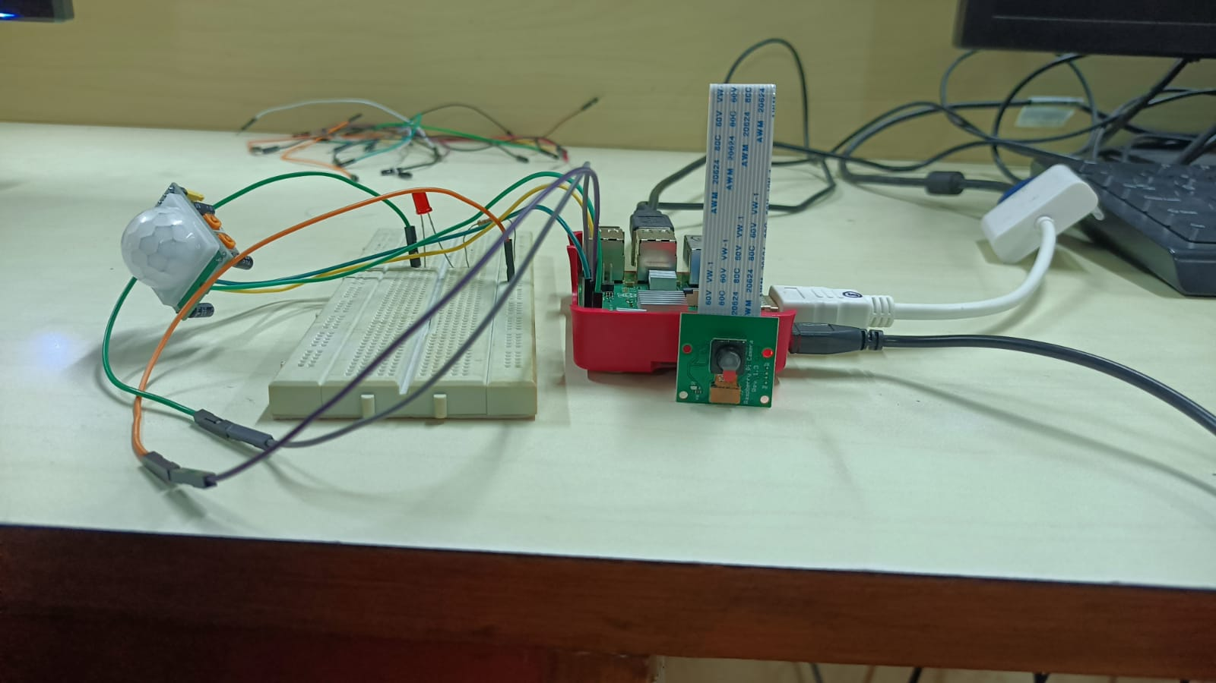
ARCHITECTURE DIAGRAM :

Slide 7
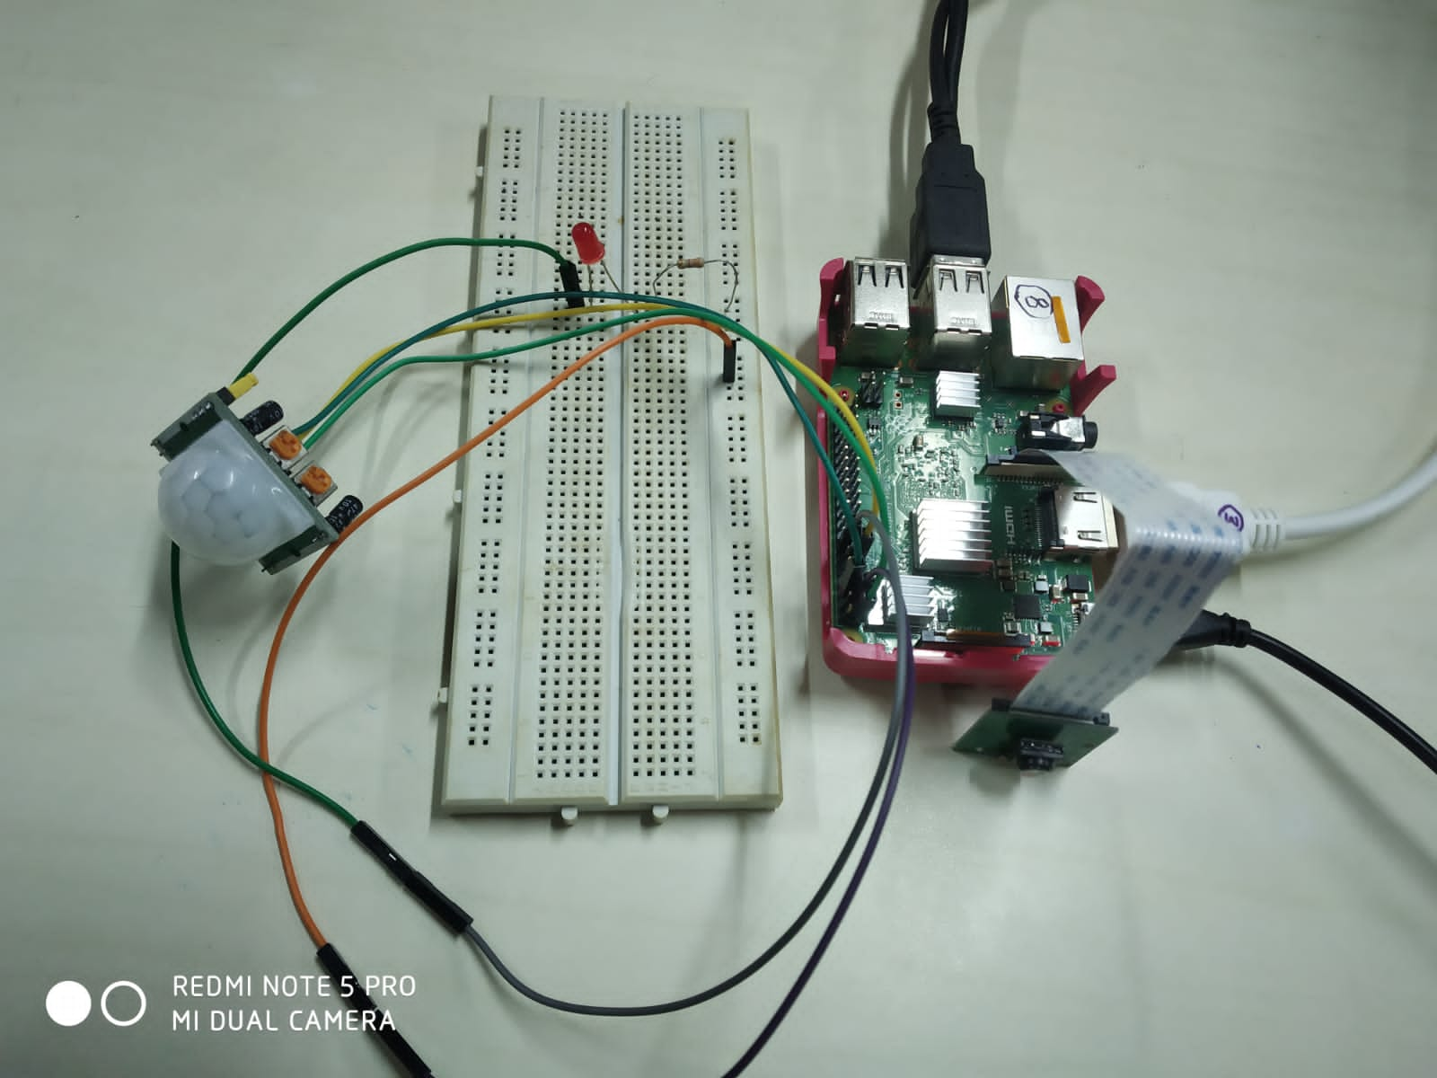
Output images:

Slide 8
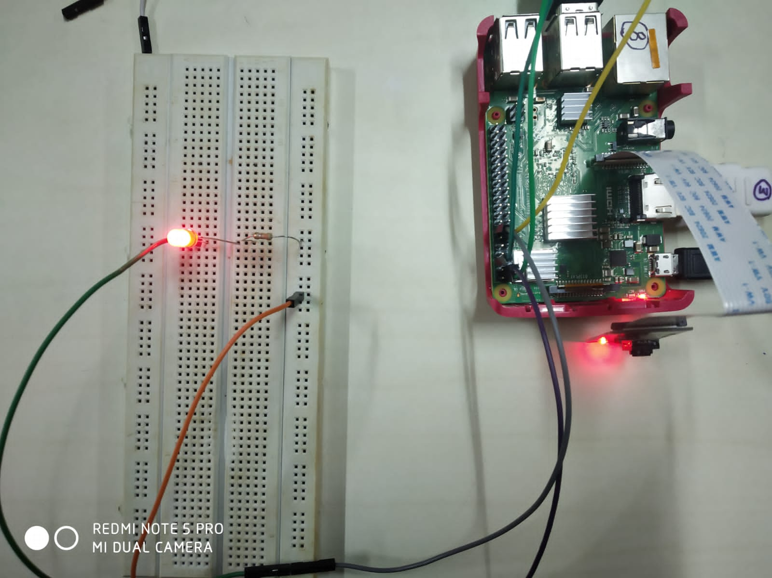
Output images:(continuation)

Slide 9
Novelty:
The novelty of the system is the inclusion of
human detection capability by HOG and SVM method
and buzzer as method to warn the house owner. The
simulation results show that the system can detect an
intruder within seconds with accuracy of 90% with
processing time around 2 seconds.

